Slide 1
はなみ
花見
Hanami

Slide 2
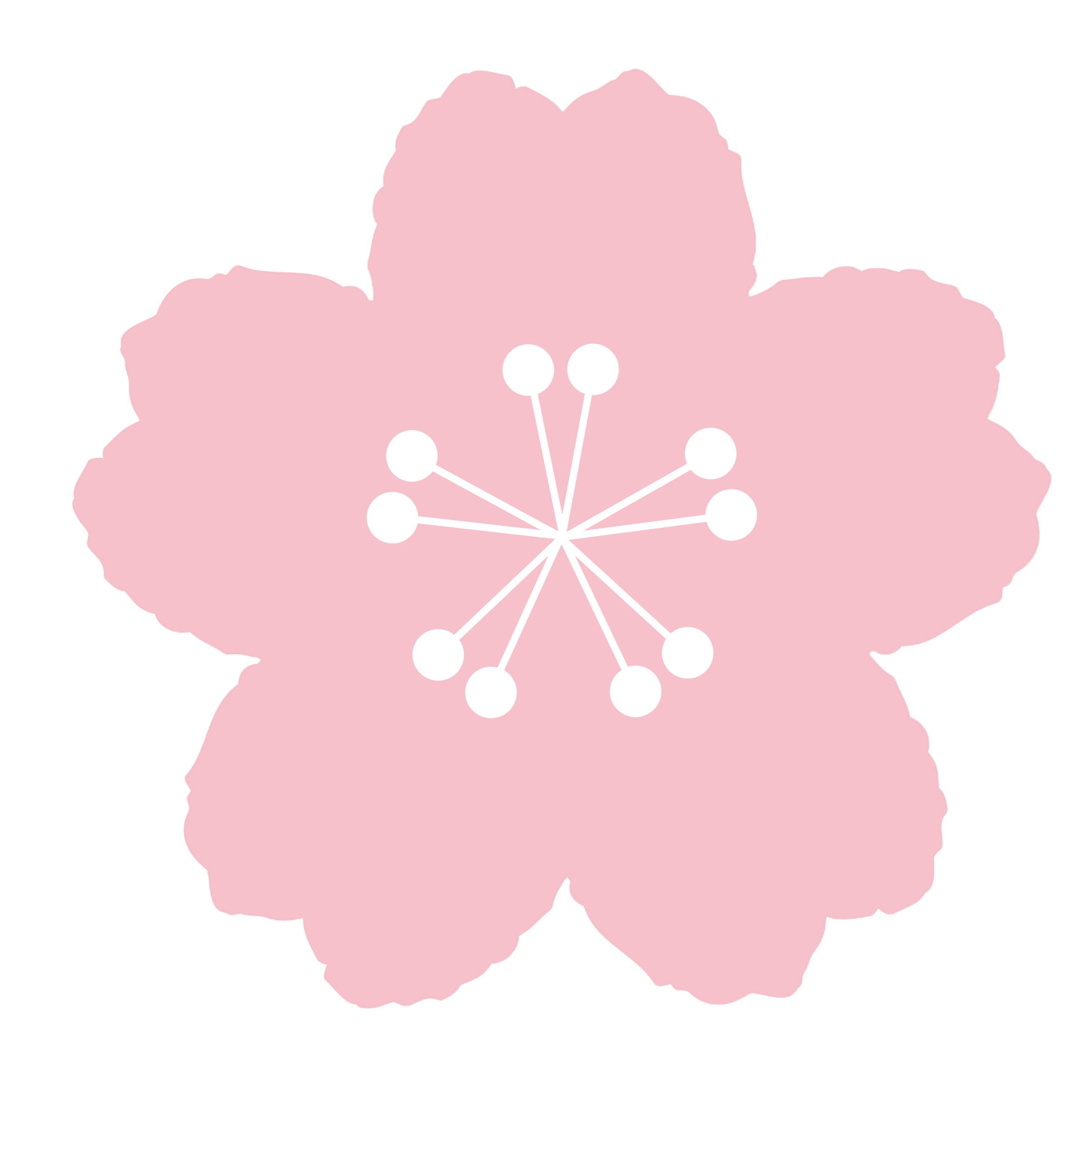
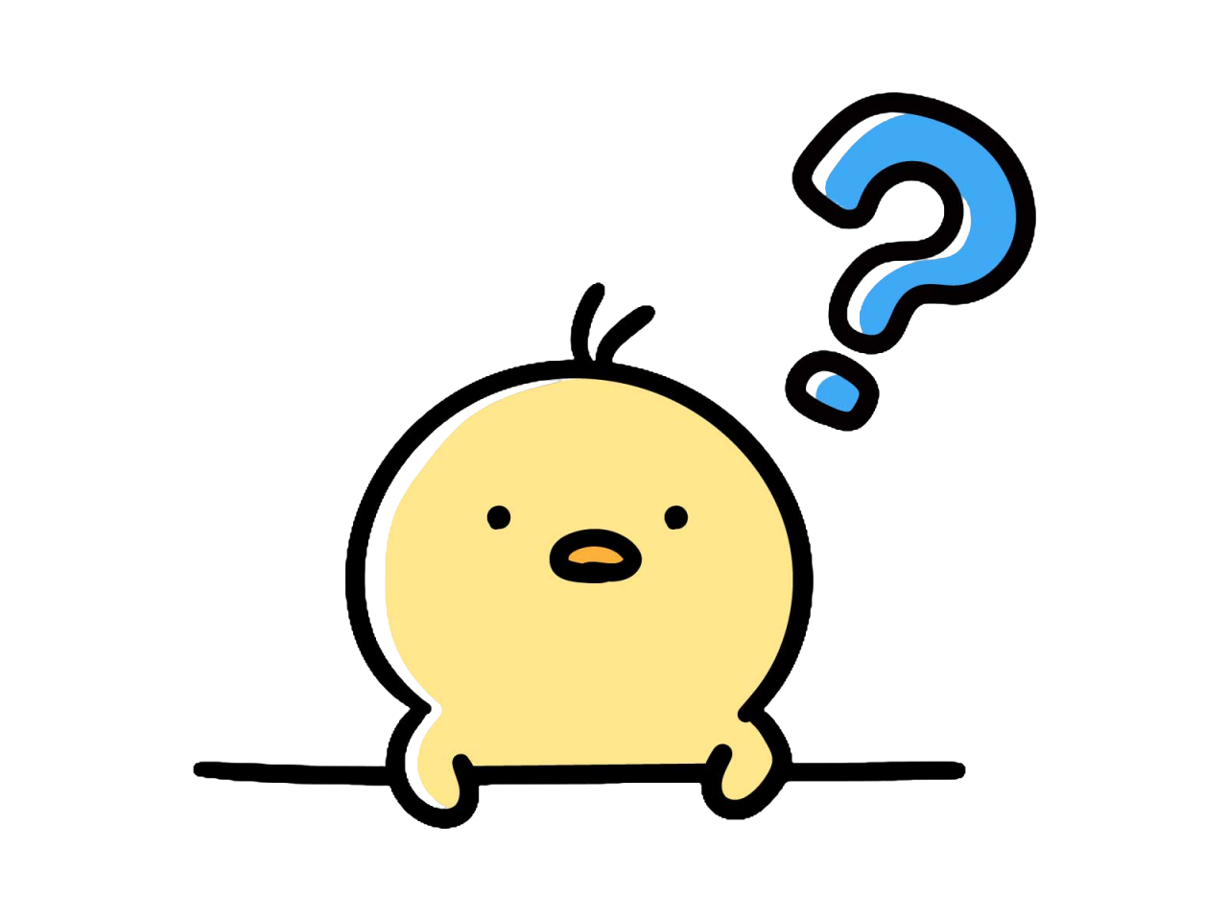
What is はなみ?
はな
み
花 見
= flower
= to see
みます
どの はな？ Which flower?
Notes:
Hanami is a Japanese traditional custom, where people appreciate springtime.
Let’s find out how Japanese people enjoy hanami!

Slide 3
さくら
わぁ～
きれい！
みんな さくらが だいすきです
People love sakura.
Notes:
Sakura is cherry blossom in English.
Note: Cherry blossoms bloom for a short time, making them fleeting and beautiful, with their falling petals symbolizing grace. This is why they have been loved in Japan for many years. The cherry blossom season also coincides with a time of both endings and new beginnings, evoking strong emotions like bittersweetness and excitement.

Slide 4
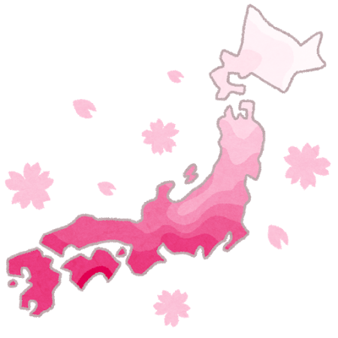
When does さくら bloom?
5がつ
4がつ
3がつ
さくらは 南から さきます。
Sakura bloom earliest in the south of Japan.
2がつ

Slide 5
What people do at はなみ?
なにをしますか？ What people do?

Slide 6
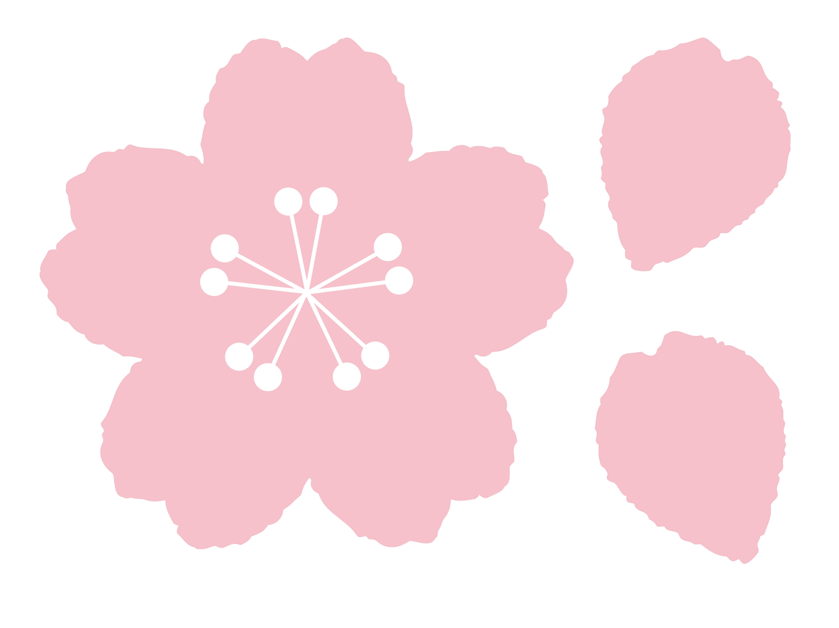
しゃしんを とります。
Taking pictures
さくらを みます。
Viewing sakura
おべんとうをたべます。
Eating obento

Slide 7
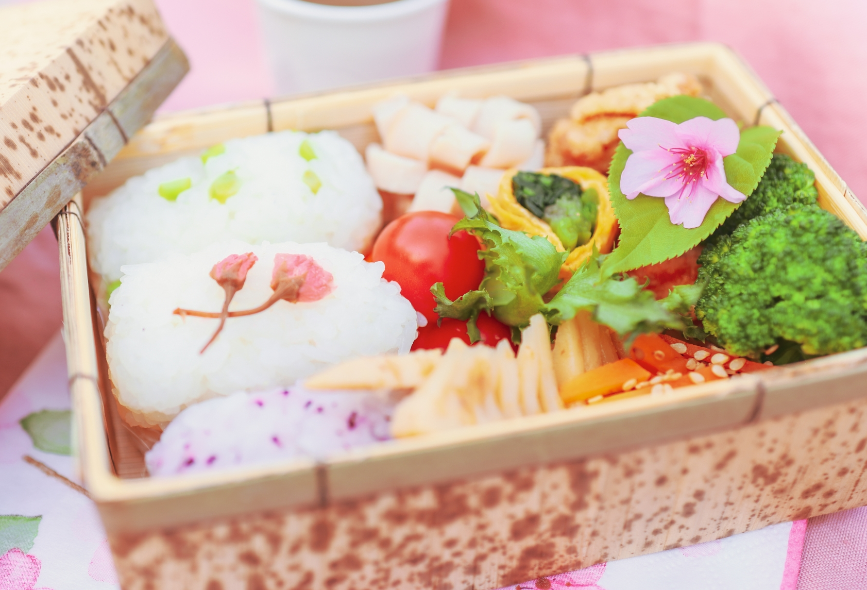
おべんとう –box lunch-
さくらがある？ Can you find any sakura?
かわいい
おいしそう！

Slide 8
おはなみのたべもの –hanami food-
なにいろ？ Which colour?
このはっぱは？ What leaf is this?
みどり
しろ
さくらのは
Sakura leaf
ぴんく
はなみ だんご
Hanami dango
さくら もち
Sakura mochi
Notes:
What do you think the pink colour represents? (flower, Sakura, spring)
参考：https://www.nihonwasyokutakubunka.com/column/cat03/21

Slide 9
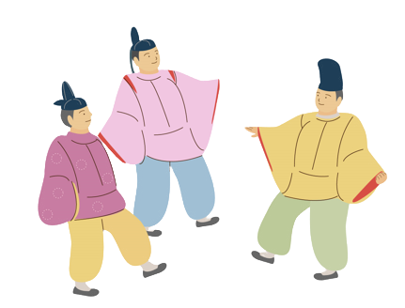
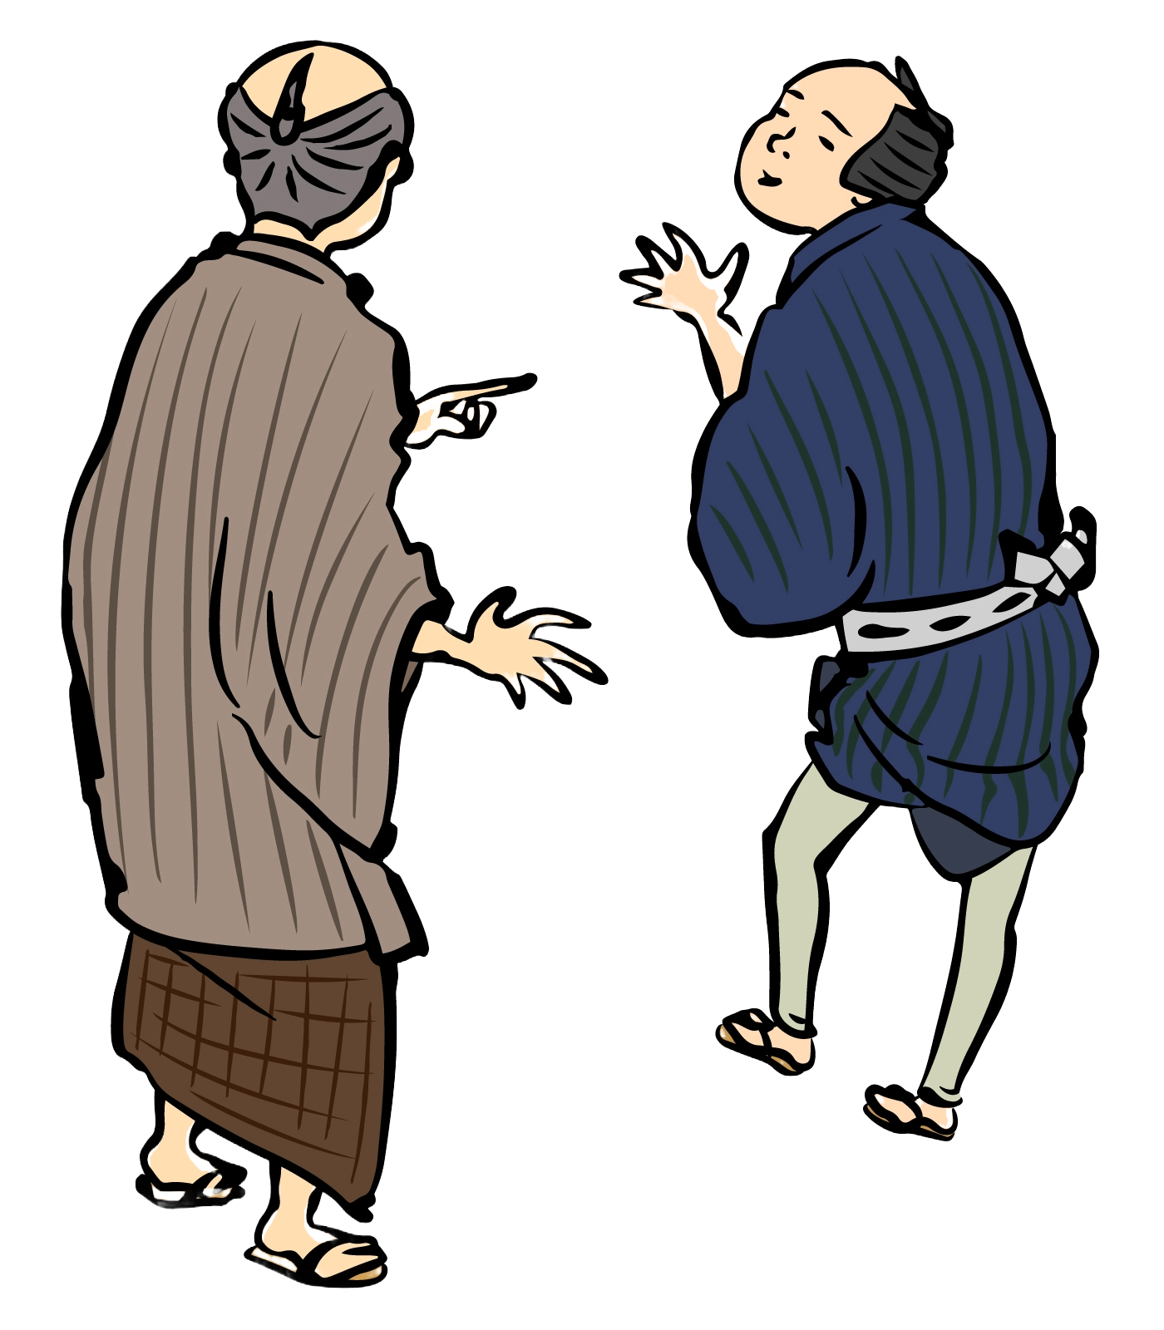
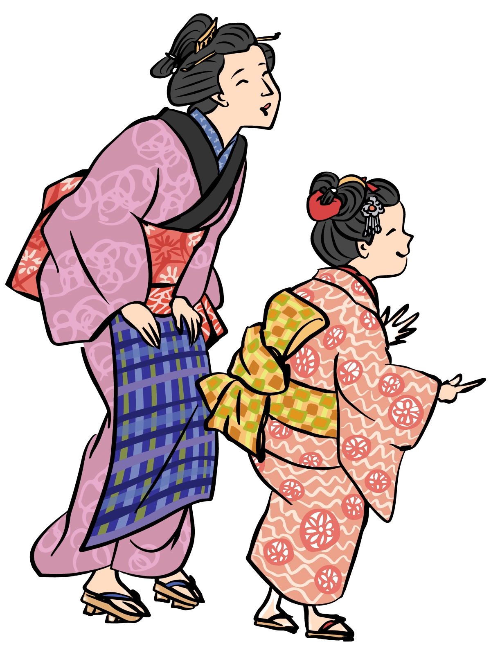
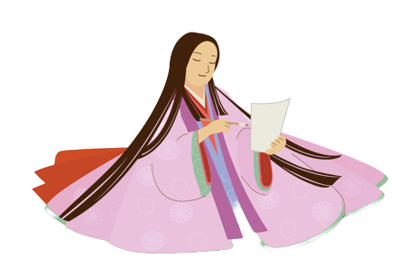
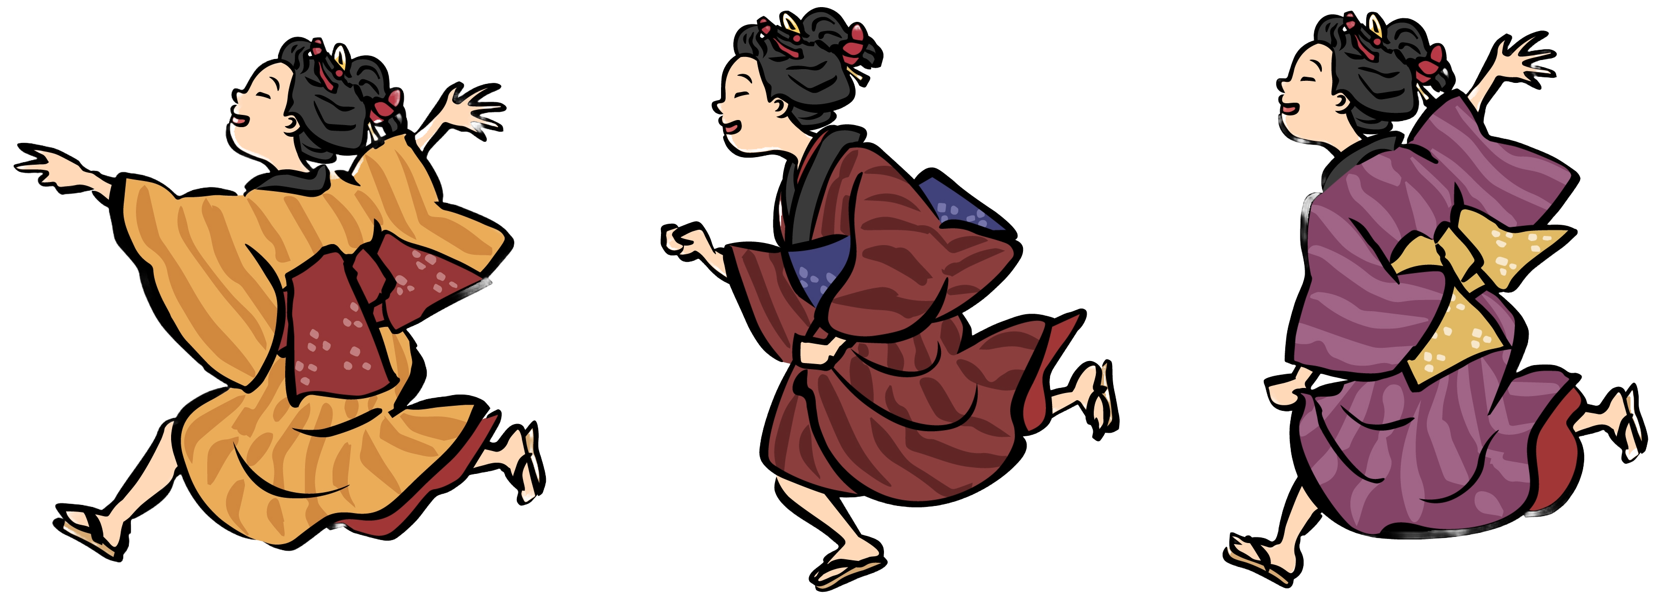
When did the はなみ tradition start?
9c.～
nobles
17c.～
commoners
In the Heian period (9c), nobles appreciated さくら and enjoyed composing poems. In the Edo period (17c), the custom of はなみ spread among commoners, and people started enjoying gathering under さくら trees. This custom continues to today.

Slide 10
Let’s see はなみ
たのしそう

Slide 11
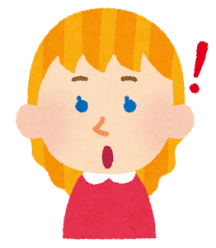
Let’s see はなみ
おみせも
あるよ
ひとが
たくさん！

Slide 12
Let’s see はなみ
よるも
はなみ！

Slide 13
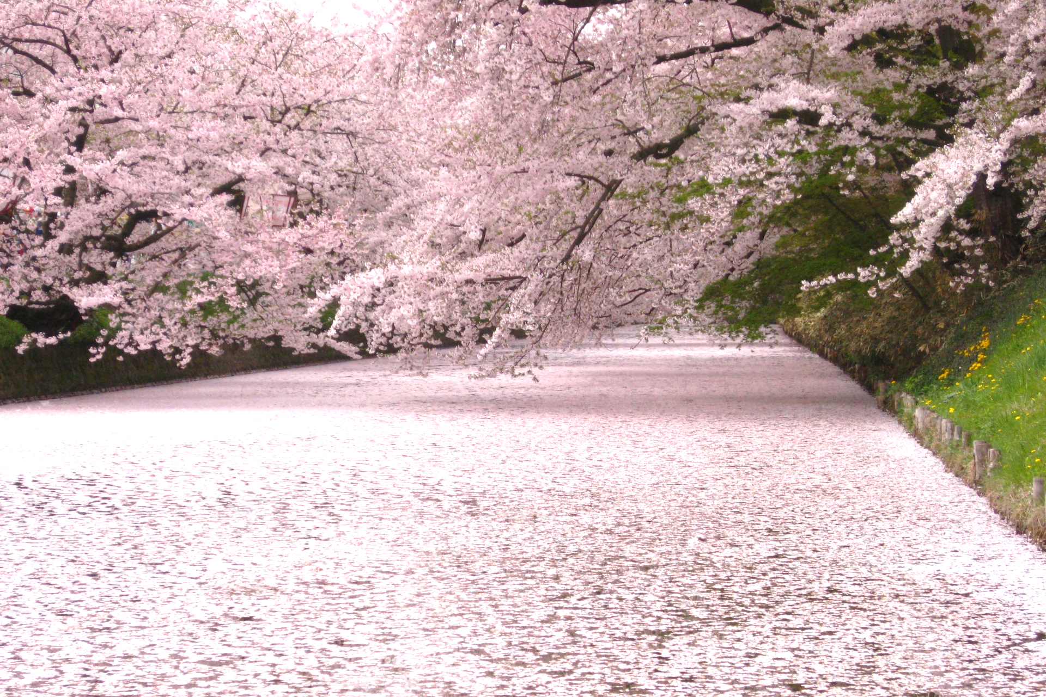
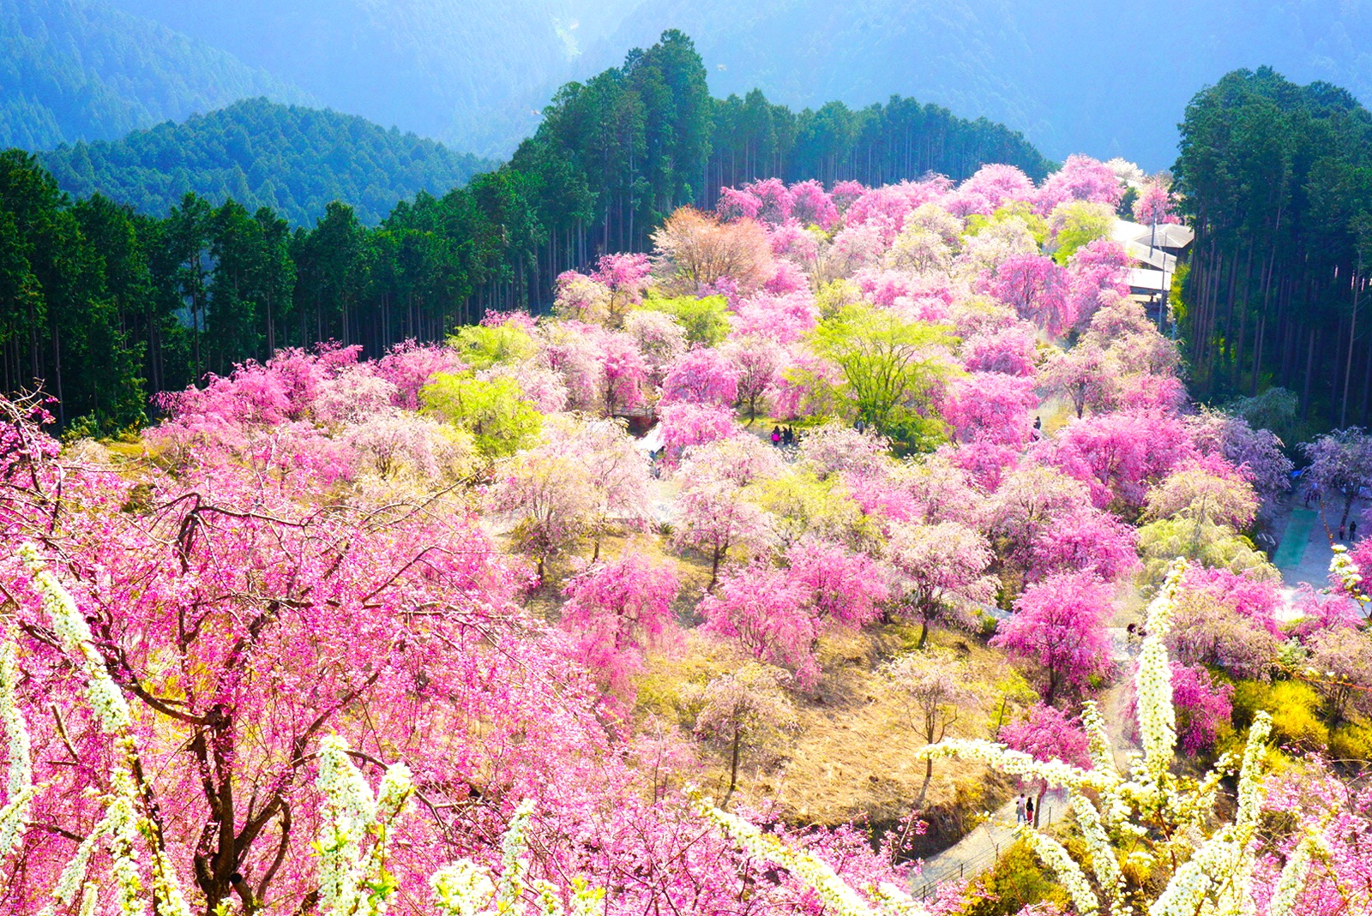
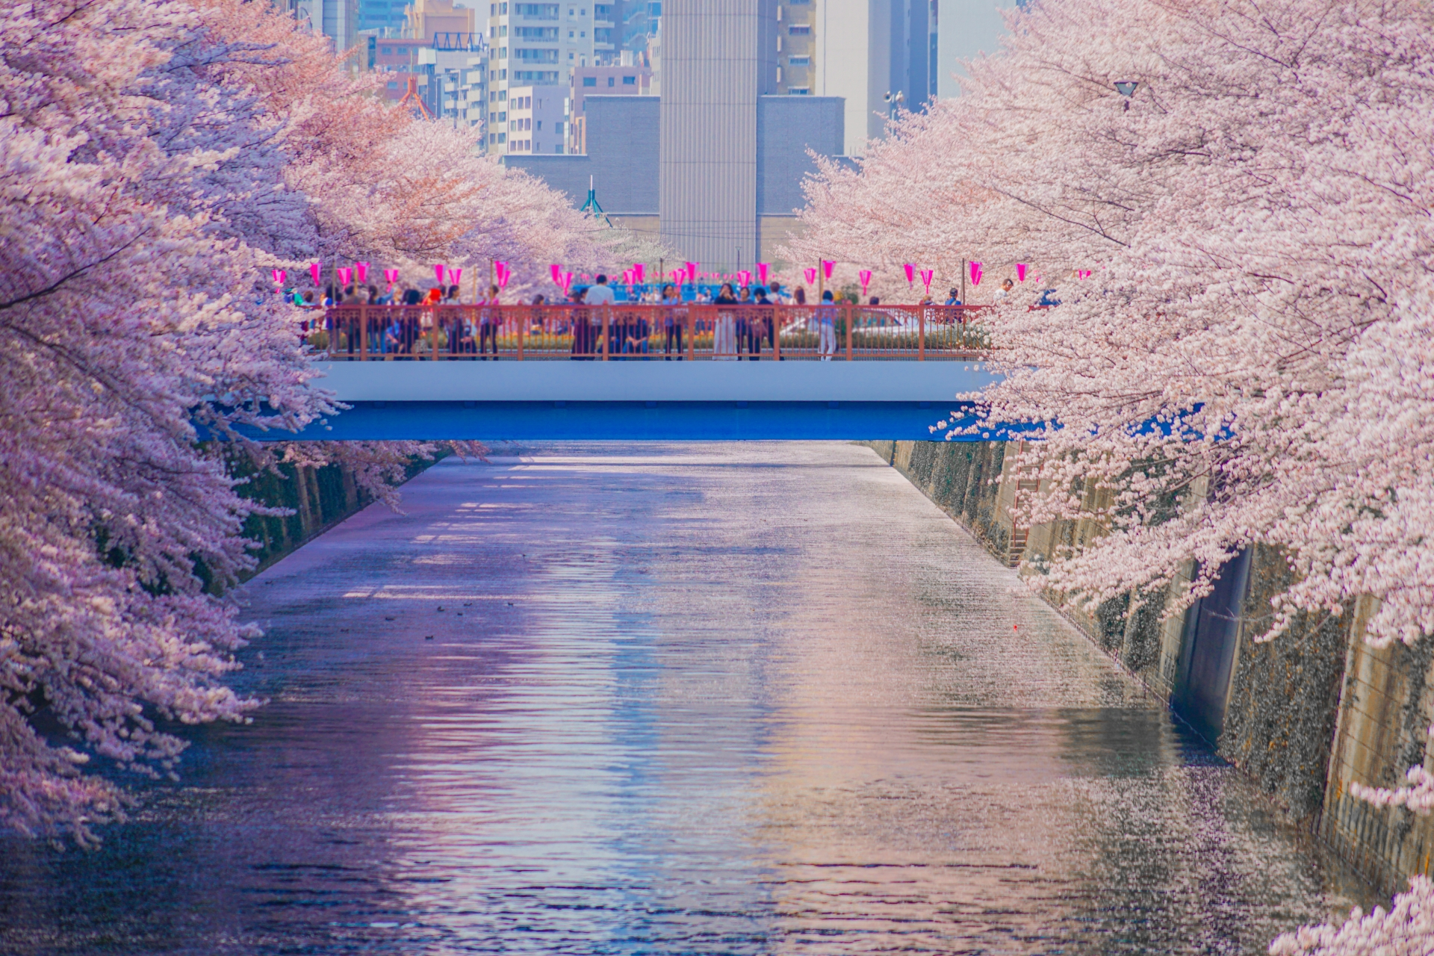
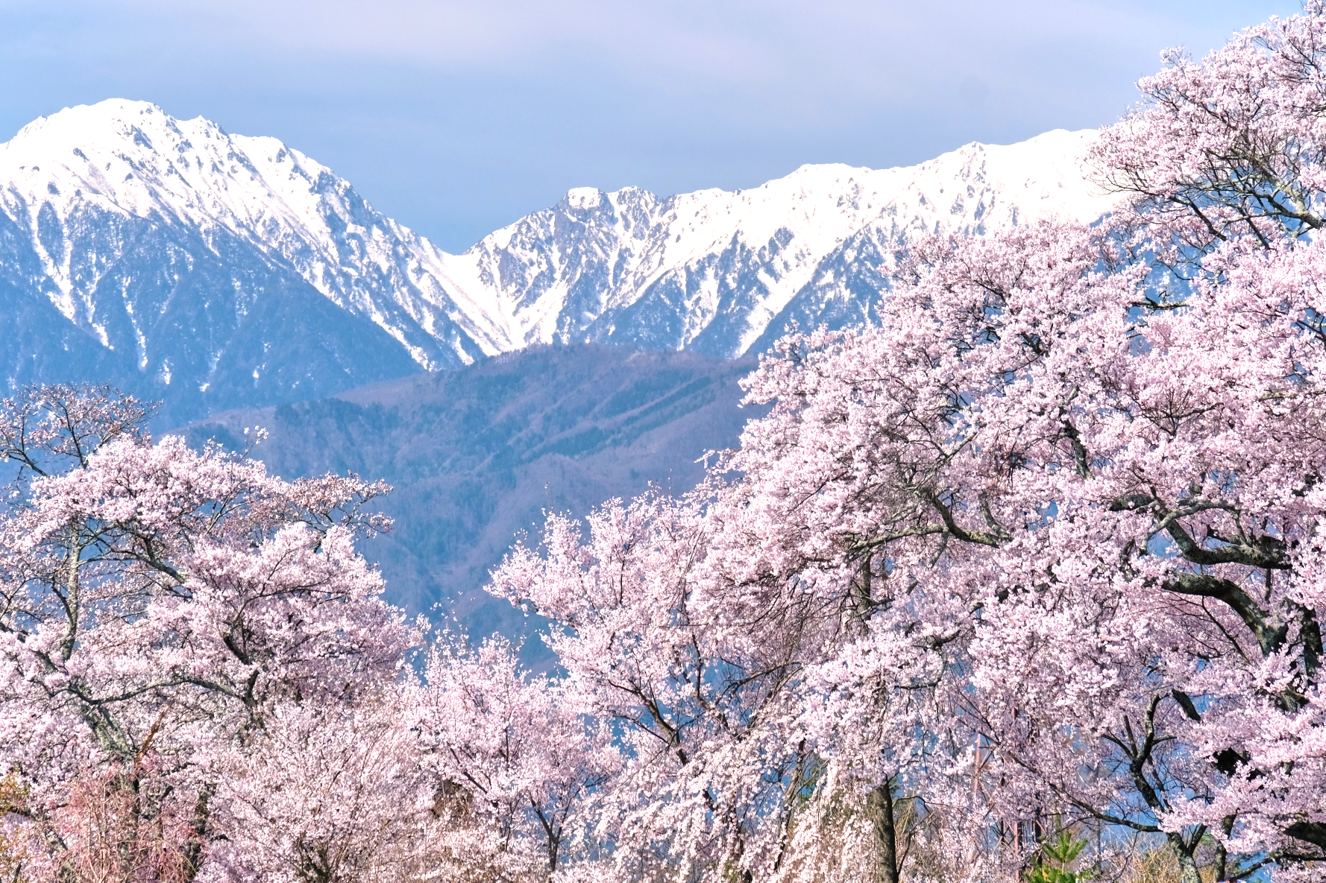
Famous はなみ spots
なら
あおもり
きれい！
とうきょう
ながの
Notes:
Note
Nara : Mt. Yoshino
Nagano : Takato Castle Site Park
Aomori : Hirosaki Park
Tokyo : Meguro River

Slide 14
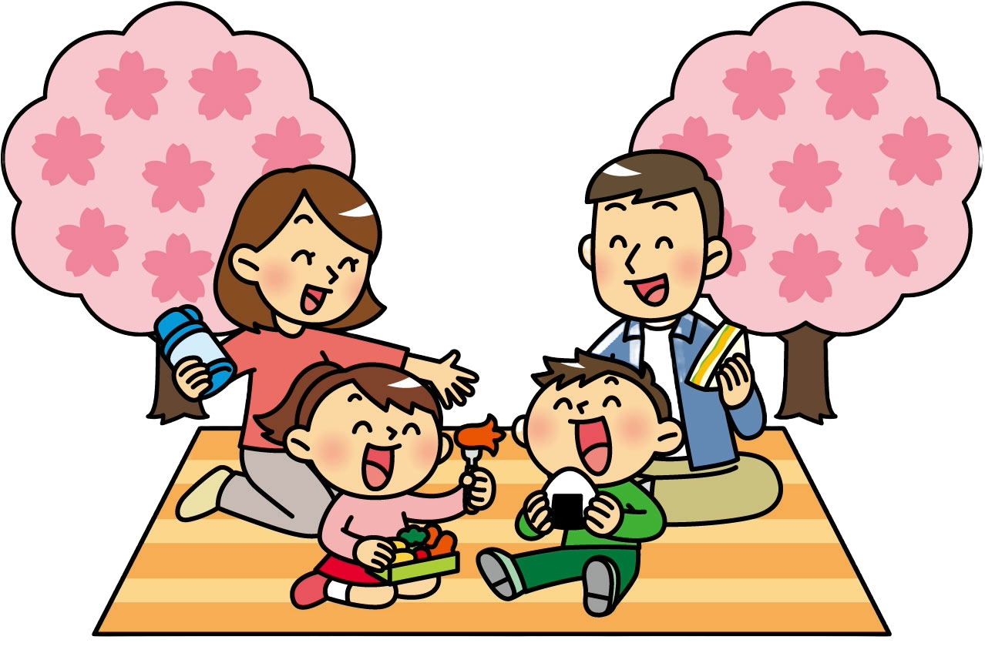
おはなみ 〇✕ クイズ
 | People appreciate さくら during はなみ.
 | People enjoy おべんとう under さくら trees.
 | The はなみ tradition started 120 years ago.
○
○
✕
1200 years ago

Slide 15
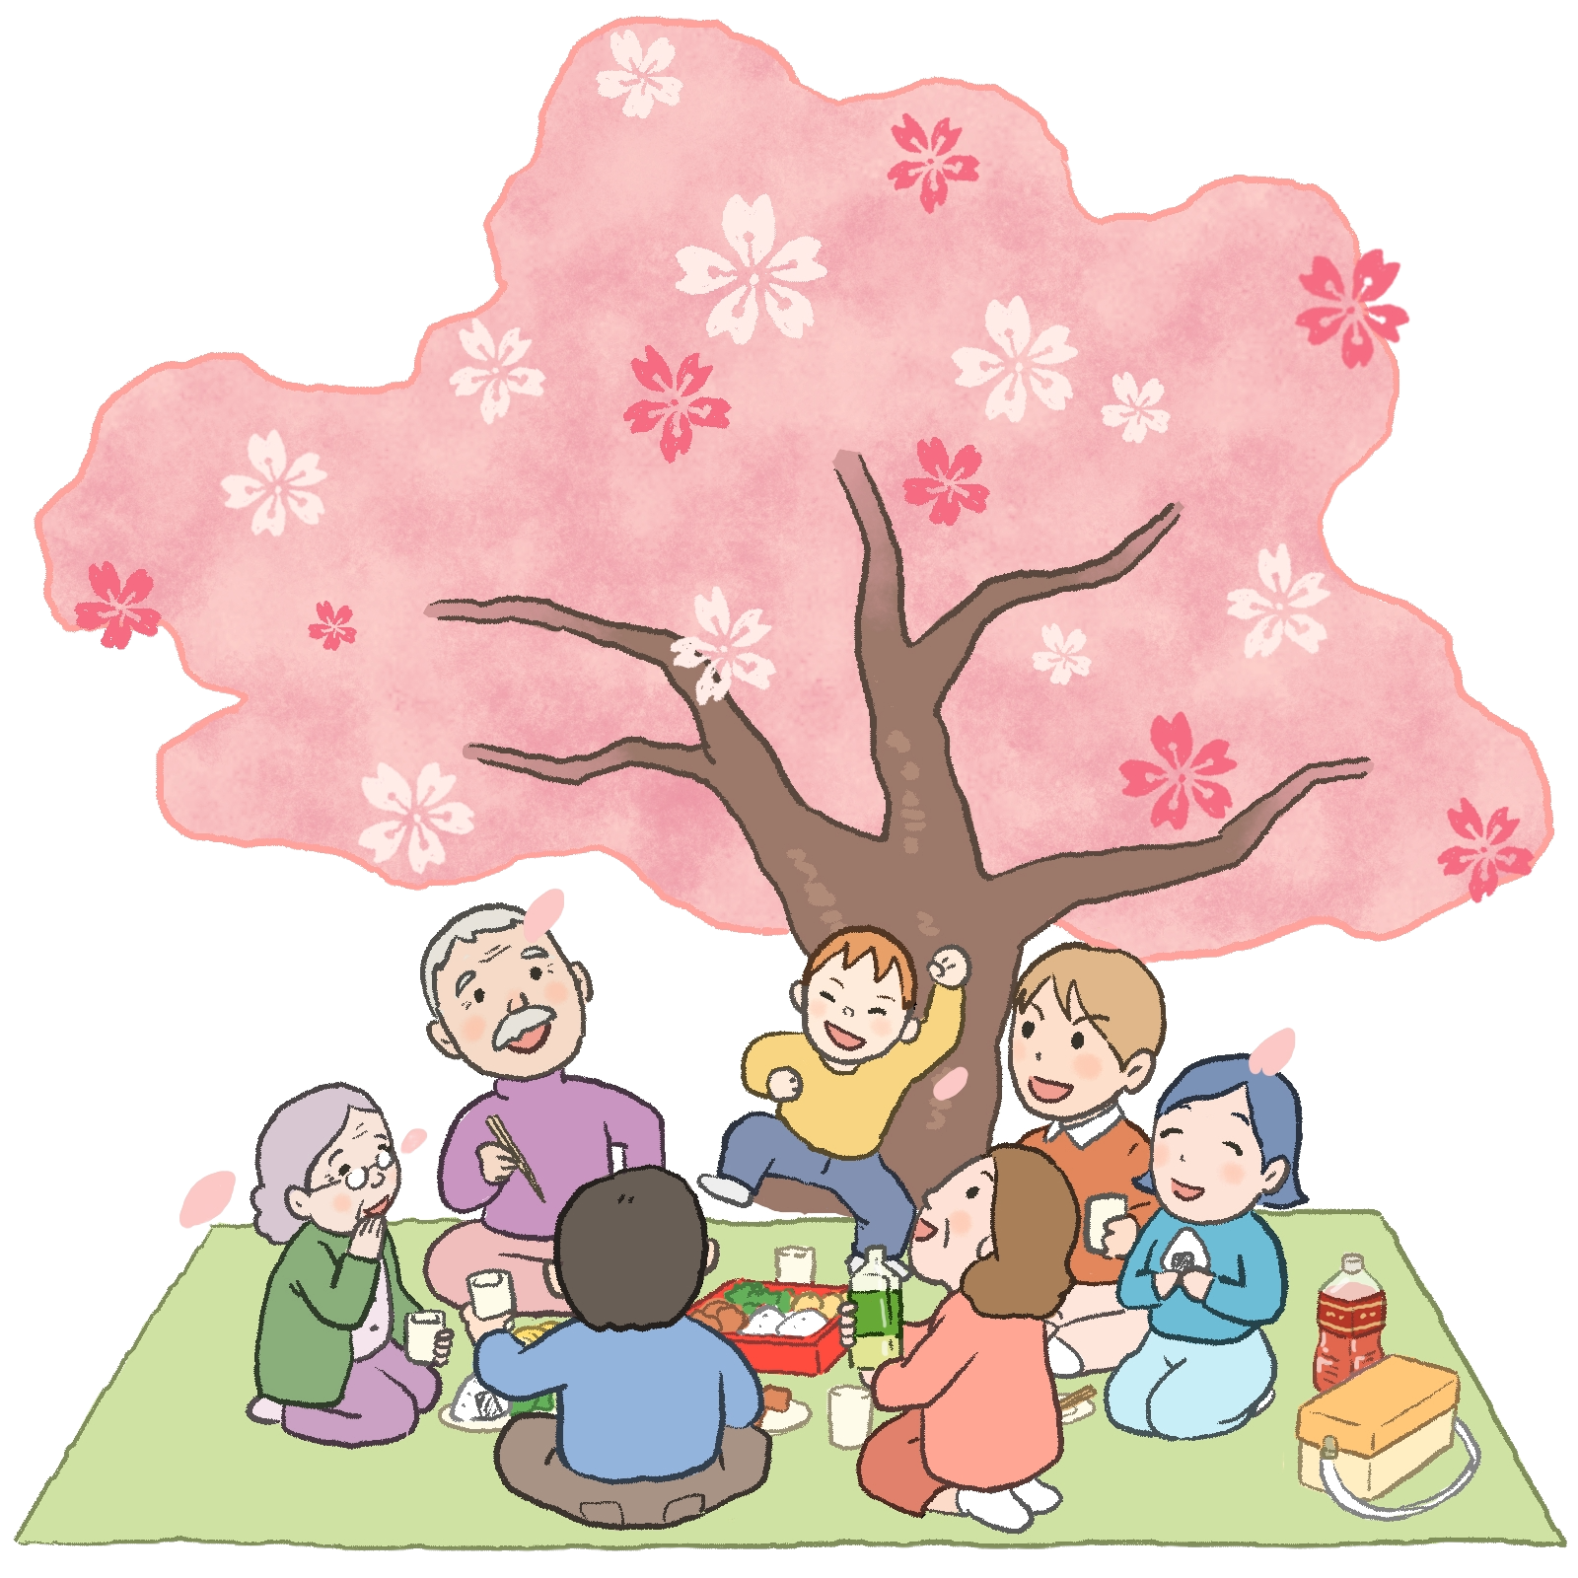
Enjoy beauty of springtime
おしまい

