Slide 1
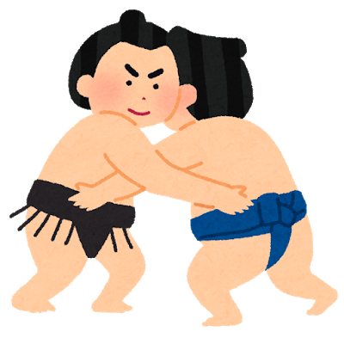
すもうであそぼう！
Sumo games in class
© The Japan Foundation, Sydney, 2019.

Slide 2
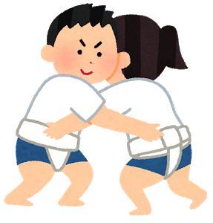
いろいろなすもう various types of sumo
There are many variations of Sumo which can be played in class. The good news is that you can keep your clothes on when you play!
Let’s find out what they are.
© The Japan Foundation, Sydney, 2019.

Slide 3
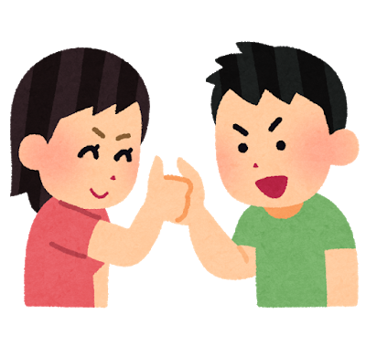
1
ゆびずもうです。
ゆびで すもうをします。
おやゆびを 10びょう おさえたら、かちです。
This is finger sumo. You wrestle with your fingers. If you hold down your opponent’s thumb for 10 seconds, you are the winner.
© The Japan Foundation, Sydney, 2019.

Slide 4
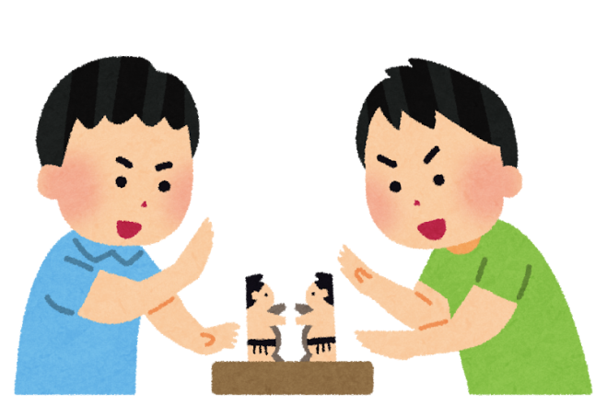
2
トントンずもうです。かみの りきしで、たたかいます。
つくえを、トントンたたきます。りきしが たおれたら、
まけです。
This is tonton (knock knock) sumo. Wrestlers made of paper are used. The game is played by hitting the table, making a drumming sound. If the wrestler falls down, you lose the game.
© The Japan Foundation, Sydney, 2019.

Slide 5
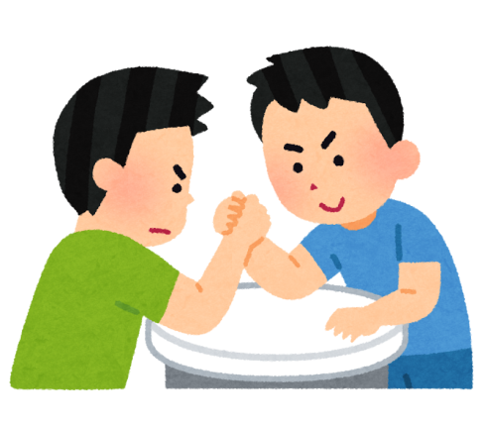
3
うでずもうです。
うでで すもうをします。
あいてのてをおさえて、つくえについたら、かちです。
This is arm wrestling sumo. If you pin your opponent’s hand down to the table you are the winner.
© The Japan Foundation, Sydney, 2019.

Slide 6
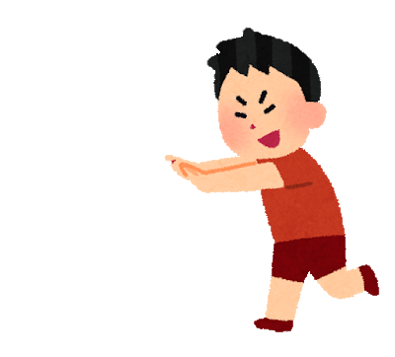
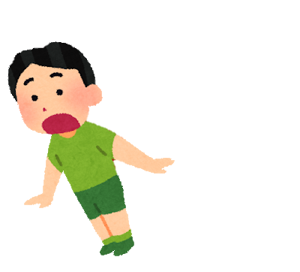

4
ておしずもうです。
てで おして、すもうをします。
あしが うごいたら、まけです。
This is called hand-pushing sumo. You push your opponent’s hands with your hands while standing still. If you lose your balance or if your feet move, you lose.
© The Japan Foundation, Sydney, 2019.

Slide 7
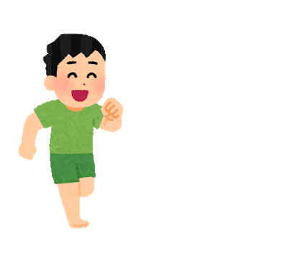
5
けんけんずもうです。
かたあしで、すもうをします。
あしがゆかについたり、リングからでたら、まけです。
This is one-legged hopping sumo. You push your opponent’s hands with your hands while hopping on one foot. If you lose your balance and your other foot touches the floor, or if you step out of the ring, you lose the bout.
© The Japan Foundation, Sydney, 2019.

Slide 8

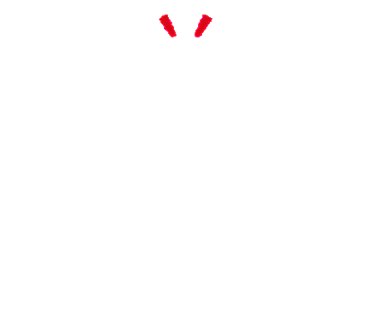
6
しりずもうです。
おしりで おして、すもうをします。
あしが うごいたら、まけです。
This is called backside sumo. You stand back-to-back and try to push your opponent out of balance with your backside. The one who moves his/her feet loses the bout.
© The Japan Foundation, Sydney, 2019.

Slide 9
とりくみ Sumo bout
You can give yourself しこな (rikishi names)
to play sumo. Fellow students can play the roles of よびだし(ring attendant) and ぎょうじ(referee), calling out the appropriate expressions.
© The Japan Foundation, Sydney, 2019.

Slide 10
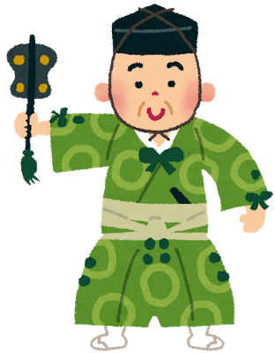
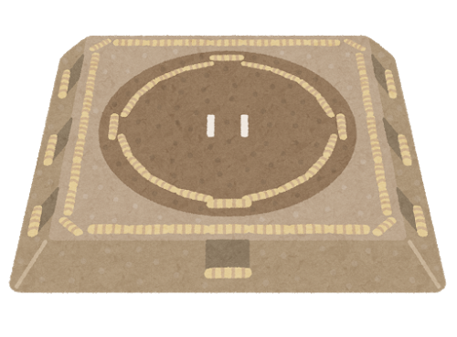
The よびだし（ring attendant）introduces the contestants
ひが-し-..............
に-し-..............
にし
西
ひがし
東
© The Japan Foundation, Sydney, 2019.

Slide 11
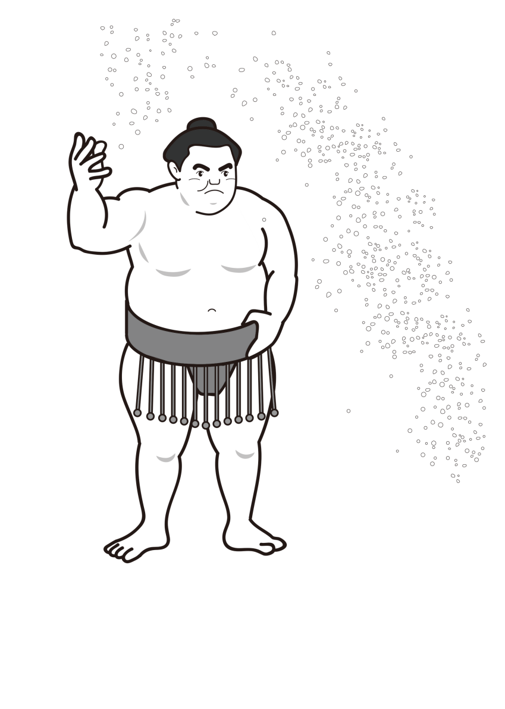
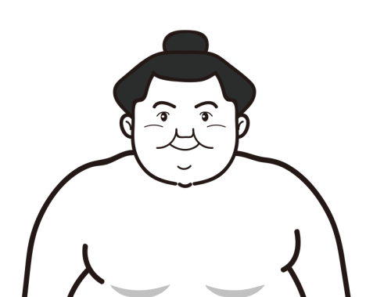
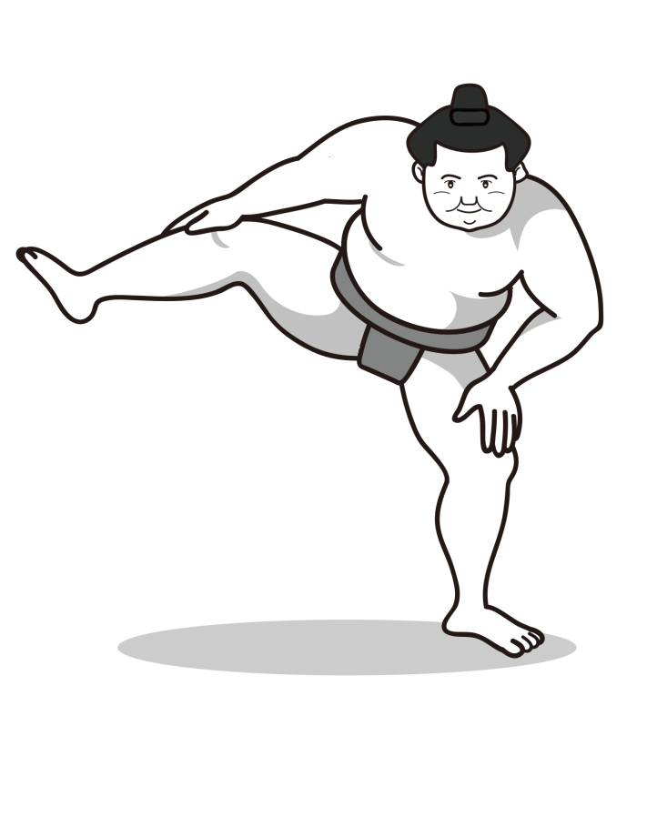
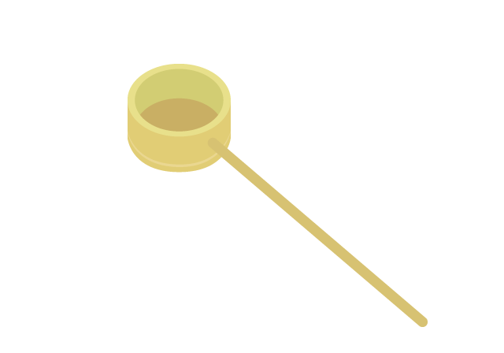
Contestants perform a series of rituals after their names are called at the start of the bout.
eg,
みず
くち
水で口をきれいにします
しおをまきます
しこをふみます
© The Japan Foundation, Sydney, 2019.

Slide 12
3. The bout starts when the referee（ぎょうじ）calls
out.....
はっきよい
のこった！
© The Japan Foundation, Sydney, 2019.

Slide 13
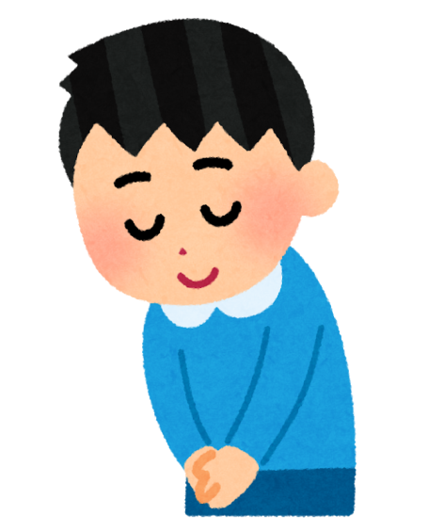
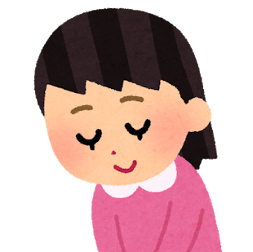
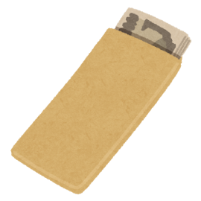
4. The referee（ぎょうじ）points his fan（ぐんばい）
to the winner and announces the name.
オージーのやま！
おじぎをします。
The contestants bow to each other and the winner receives a packet of money and goes up the ranking!
© The Japan Foundation, Sydney, 2019.

Slide 14
すもうのランク Sumo rank
Sumo wrestlers work their way up the ranks aiming for grand champion （よこづな）. The ranking can be demonstrated by a diagram in the form of a pyramid.
© The Japan Foundation, Sydney, 2019.

Slide 15
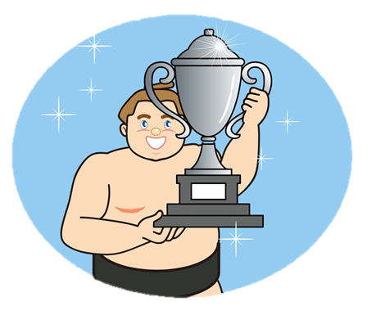
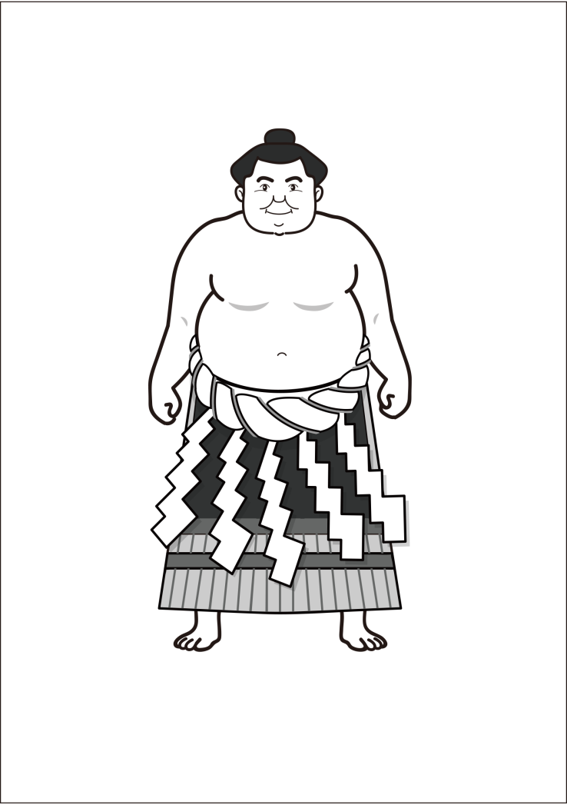
おおぜき
せきわけ
じょのくち
こむすび
まえがしら
じゅうりょう
まくした
さんだんめ
じょにだん
よこづな
© The Japan Foundation, Sydney, 2019.

Slide 16
れいぎ
Courtesy
When you compete in a sport, it is important to be respectful and polite to the opponent.
Here are some useful expressions to use when you play sumo in class.
© The Japan Foundation, Sydney, 2019.

Slide 17
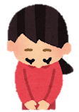
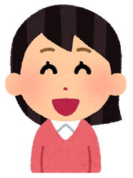
1 : What could you say before you start a match?
A: よろしくおねがいします。
2: What could you say when you finish a match?
A: ありがとうございました。
3: What could you say when you win a match?
A: かった。/ かちました。
© The Japan Foundation, Sydney, 2019.

Slide 18
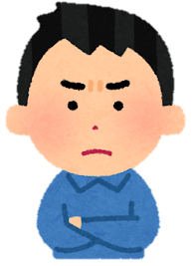
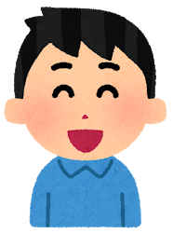
4 : What would you say when you lose a match?
A: まけた。/ まけました！
5 : What would you say to a person who lost a match?
A: ざんねん！/ ざんねんでしたね。
6 : What would you say to a person who won a match?
A: すごい！ / つよい！
© The Japan Foundation, Sydney, 2019.

Slide 19
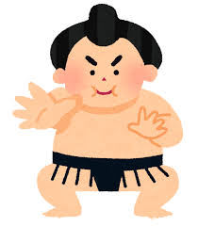
Now you are ready to play a match!
がんばってください !
© The Japan Foundation, Sydney, 2019.

