Slide 1
日本について About Japan
Round 3
Copyright(c)The Japan Foundation, Sydney 2016

Slide 2
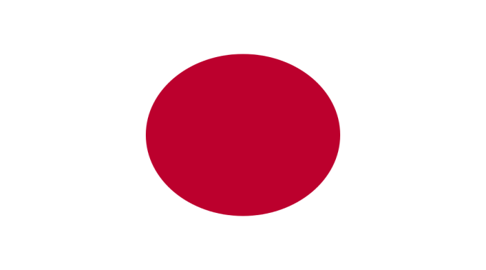
Q1. The most common surname in Australia is Smith. What is the most common surname in Japan?
?
Smith
Copyright(c)The Japan Foundation, Sydney 2016

Slide 3
Q1. What is the most common surname in Japan?
あ
い
SATOU
TOYOTA
さとう
とよた
う
え
SUZUKI
MATSUDA
すずき
まつだ
Copyright(c)The Japan Foundation, Sydney 2016

Slide 4
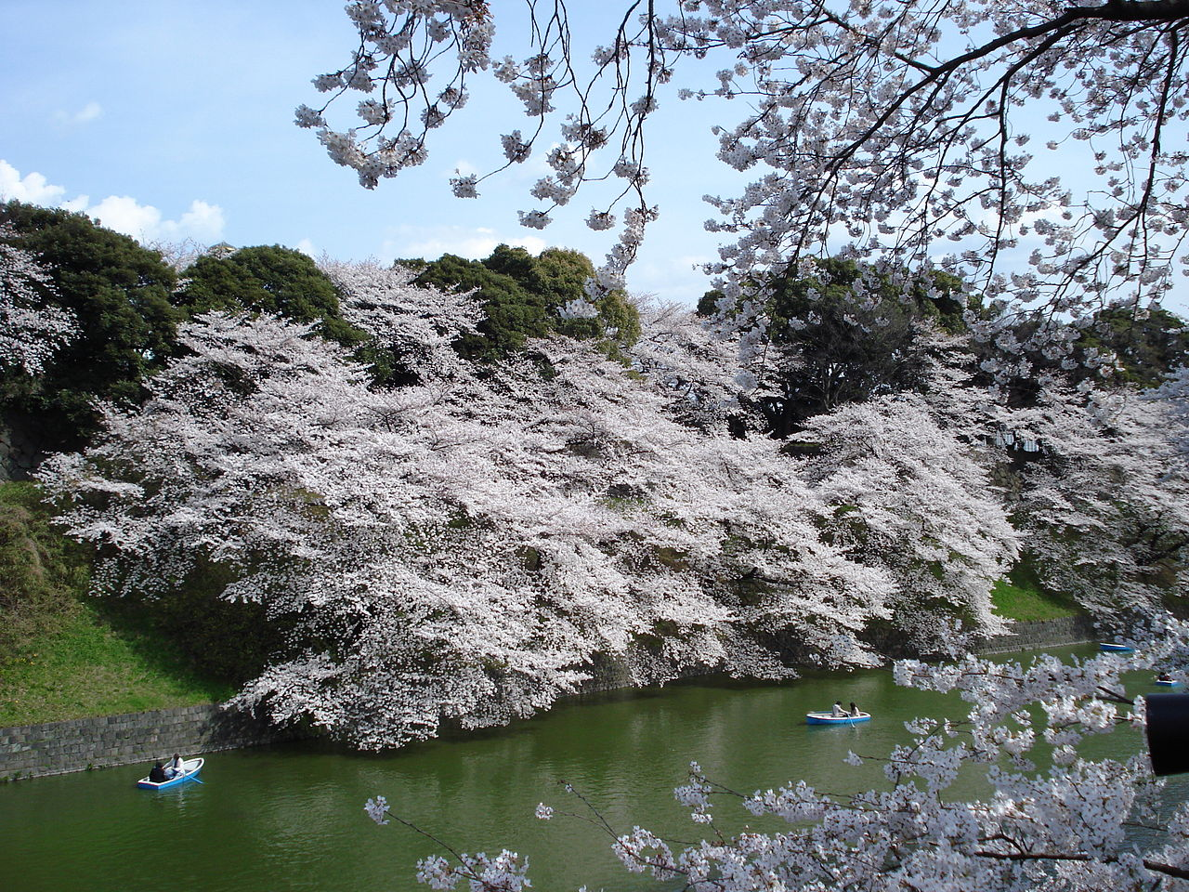
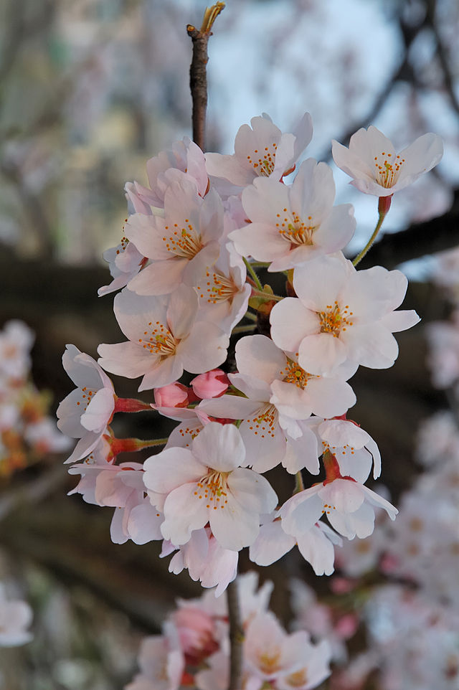
Q2. This is sakura (cherry tree) In what season do they bloom?
Copyright(c)The Japan Foundation, Sydney 2016

Slide 5
Q2. In what season do sakura bloom?
あ
い
HARU
NATSU
はる
なつ
う
え
AKI
FUYU
あき
ふゆ
Copyright(c)The Japan Foundation, Sydney 2016

Slide 6
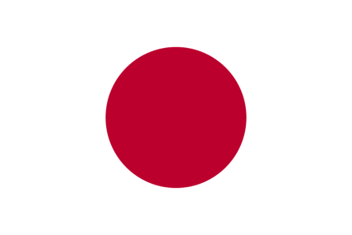
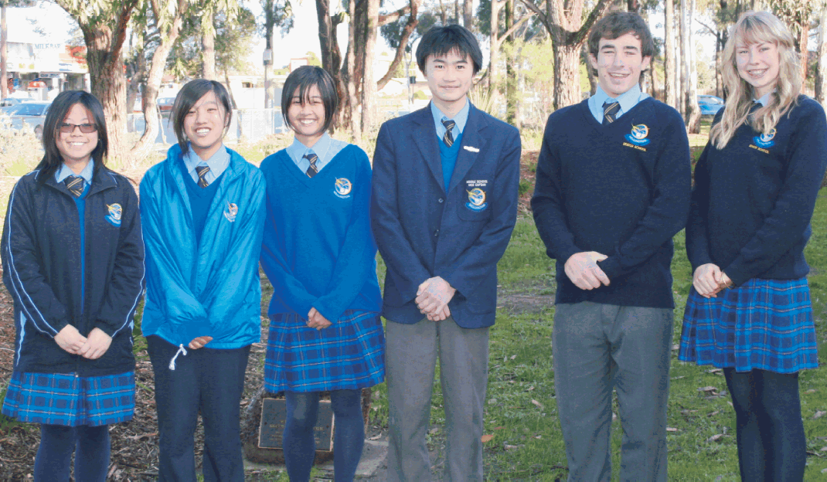
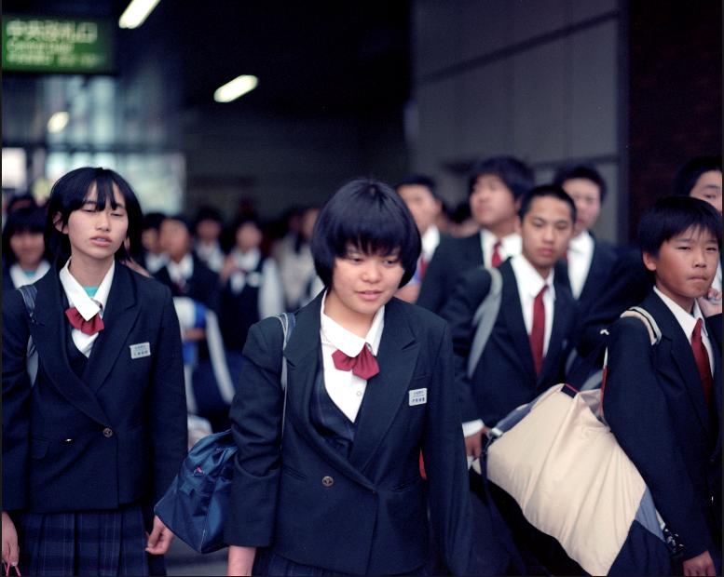
Q3. In Australia the school year starts in January-February. When does the school year start in Japan?
1月ー2月
?
Copyright(c)The Japan Foundation, Sydney 2016

Slide 7
Q3. When does the school year start in Japan?
あ
い
GATSU
GATSU
１月
2月
う
え
GATSU
GATSU
3月
４月
Copyright(c)The Japan Foundation, Sydney 2016

Slide 8
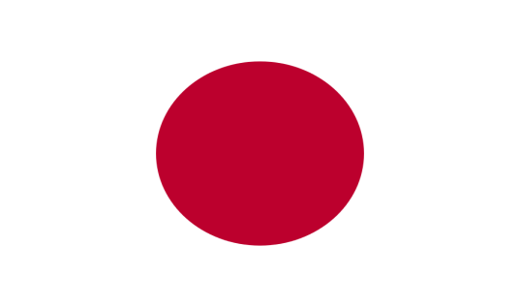
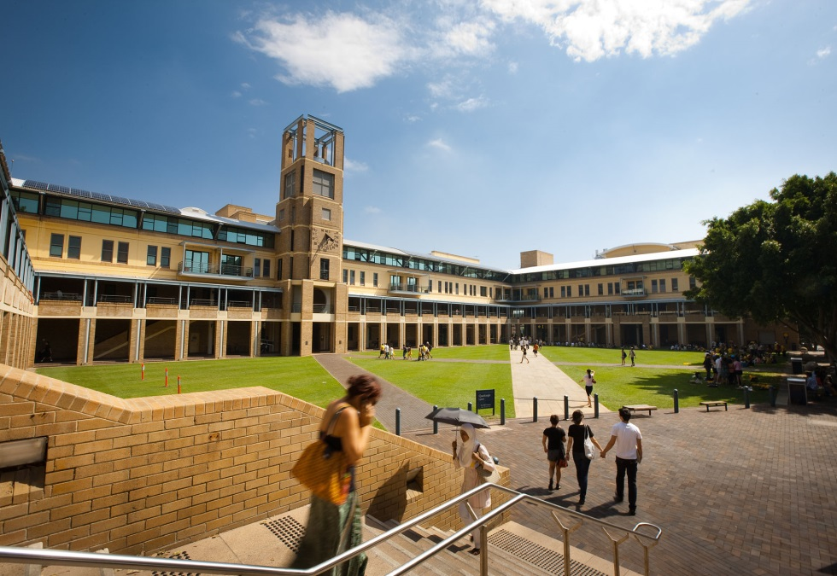
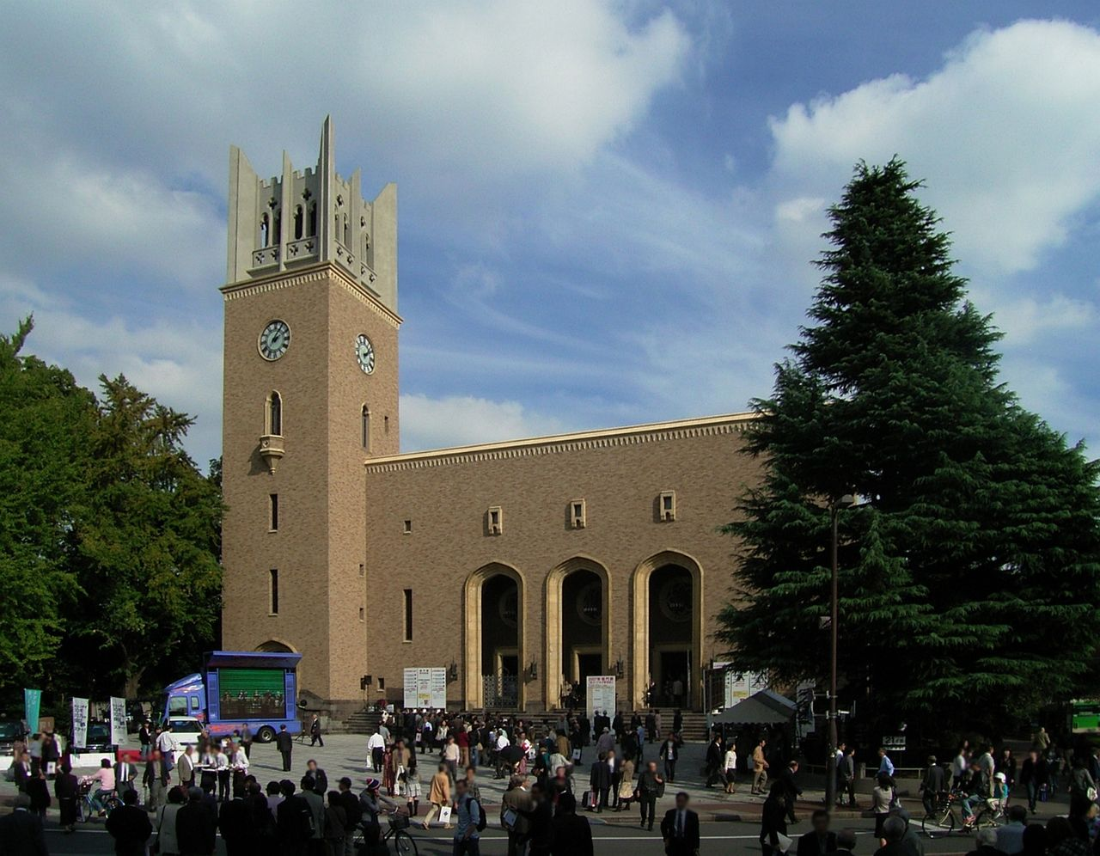
Q4. In Australia there are 43 universities. How many universities are there in Japan?
43
？
Copyright(c)The Japan Foundation, Sydney 2016

Slide 9
Q4. How many universities are there in Japan?
あ
い
7
78
う
え
378
778
Copyright(c)The Japan Foundation, Sydney 2016

Slide 10
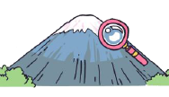
Q5. Which of these university departments exists in Japan?
あ
Dept of Mt. Fuji
ふじさんがくぶ
Dept of Ninja
にんじゃがくぶ
い
う
Dept of Manga
まんががくぶ
え
Dept of Sushi
すしがくぶ
Copyright(c)The Japan Foundation, Sydney 2016

Slide 11
Q6. In 2020 the Olympic Games will be held in Tokyo. This will be the second time. In what year were the Olympic Games first held in Tokyo?
Copyright(c)The Japan Foundation, Sydney 2016

Slide 12
Q6. In what year were the Olympic Games first held in Tokyo?
あ
い
NEN
NEN
1956年
1964年
う
え
NEN
NEN
1988年
2000年
Copyright(c)The Japan Foundation, Sydney 2016

Slide 13
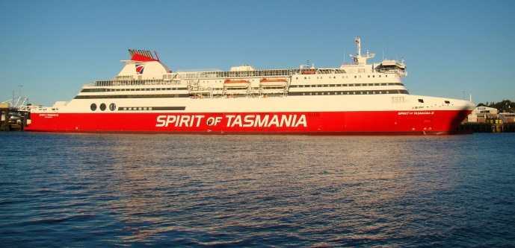
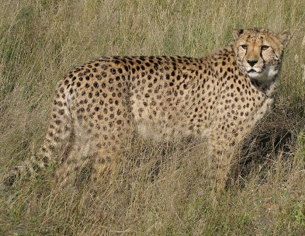
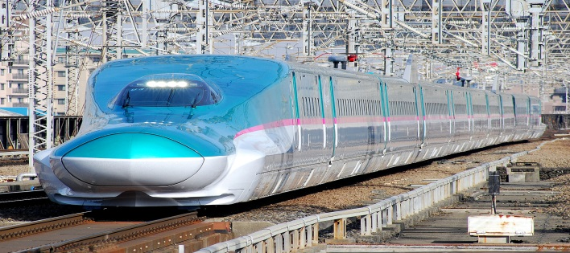
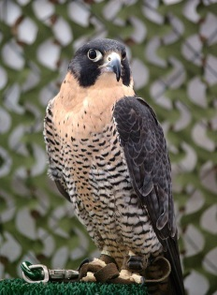
Q7. Which of these animals and vehicles is the fastest?
あ
Spirit of Tasmania
い
CHIITAA
チーター
50km/h
100km/h
う
SHINKANSEN
しんかんせん
え
HAYABUSA
ハヤブサ(Falcon)
320km/h
390km/h
Copyright(c)The Japan Foundation, Sydney 2016

Slide 14
The fastest Shinkansen is the Tohoku Shinkansen which runs 320km/ph to the northern part of Japan.
Copyright(c)The Japan Foundation, Sydney 2016

Slide 15
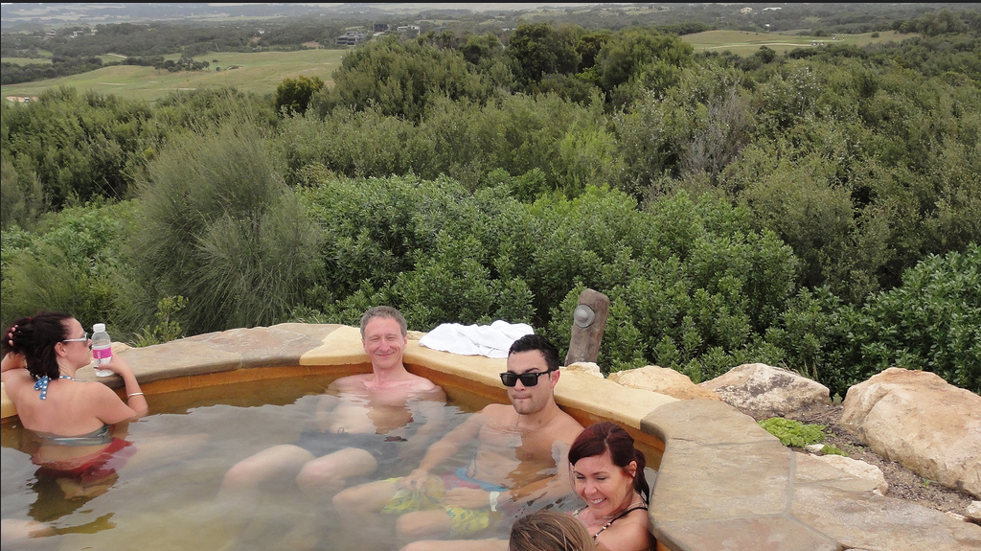
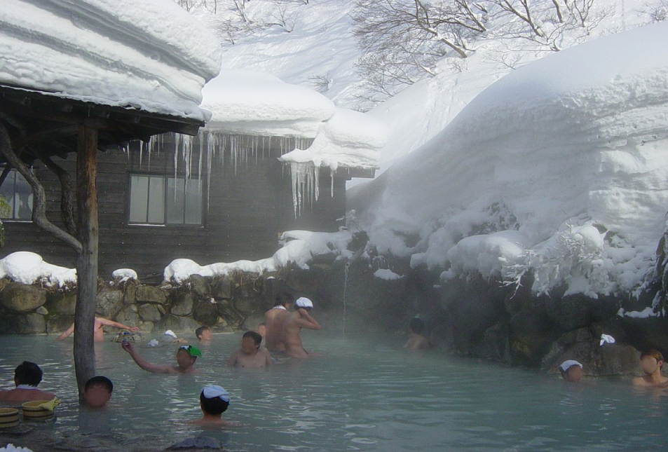
Q8. In Australia there are over 40 onsen (hot springs). About how many are there in Japan?
40↑
？
Copyright(c)The Japan Foundation, Sydney 2016

Slide 16
Q8. About how many onsen are there in Japan?
あ
い
100
500
う
え
1000
3000
Copyright(c)The Japan Foundation, Sydney 2016

Slide 17
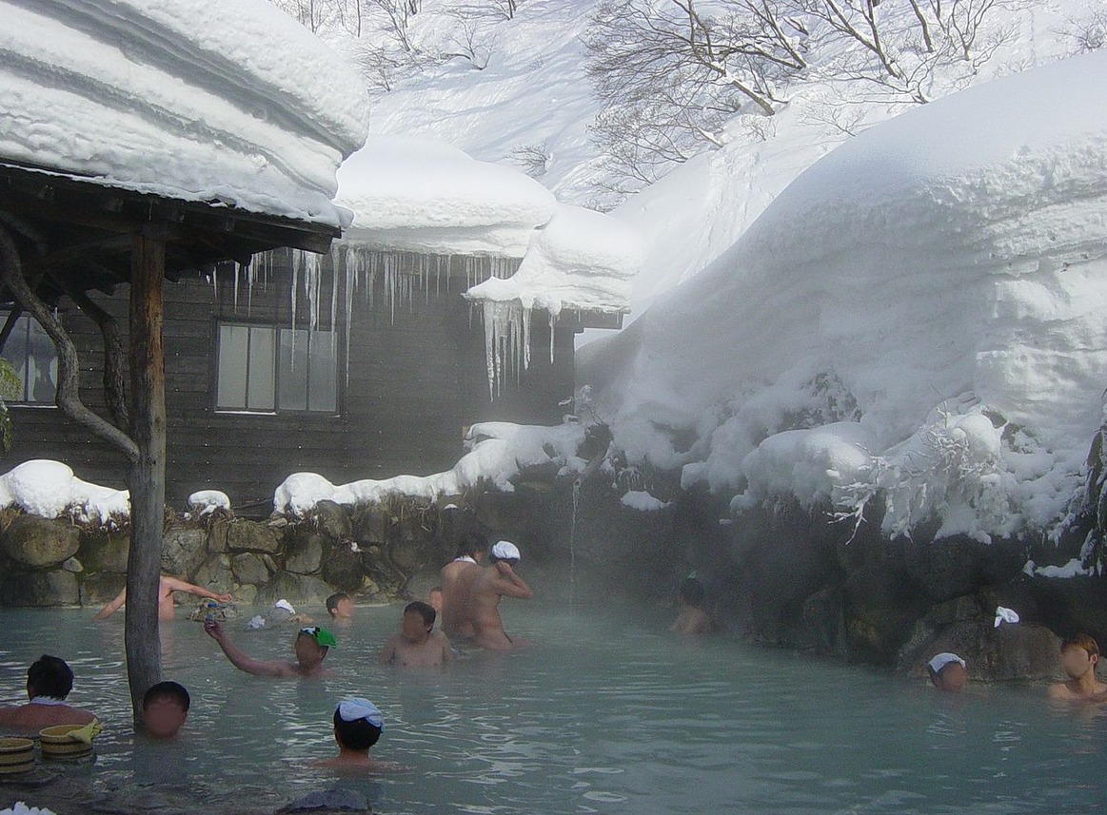
Q9. In onsen in Japan, people put a towel on their heads. Why do they do this?
Copyright(c)The Japan Foundation, Sydney 2016

Slide 18
Q9. Why do people put a towel on their heads in Japanese onsen?
あ
い
To keep their heads warm
To keep their hair dry
う
え
They are not allowed to put towels in the bath
They are avoiding the snow
falling down
Copyright(c)The Japan Foundation, Sydney 2016

Slide 19
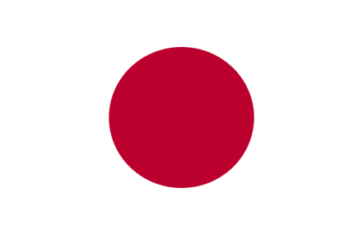
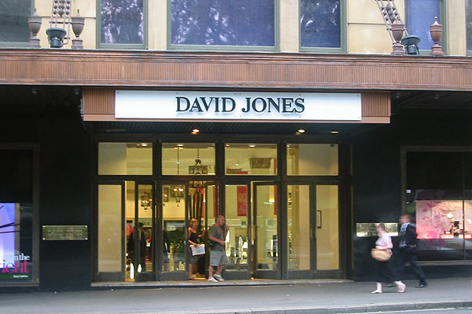
Q10. David Jones is one of the oldest department stores in the world. Which is the oldest department store in Japan?
？
Founded in 1838
Copyright(c)The Japan Foundation, Sydney 2016

Slide 20
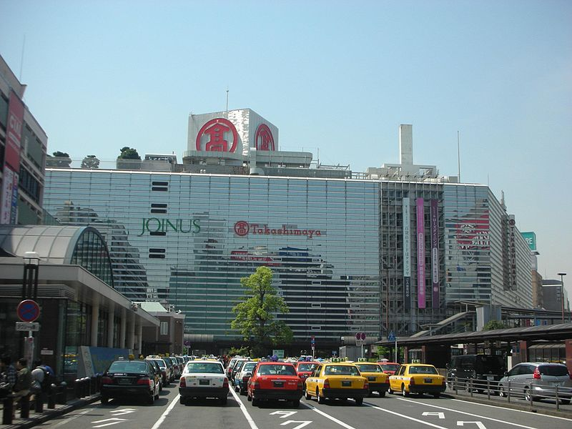
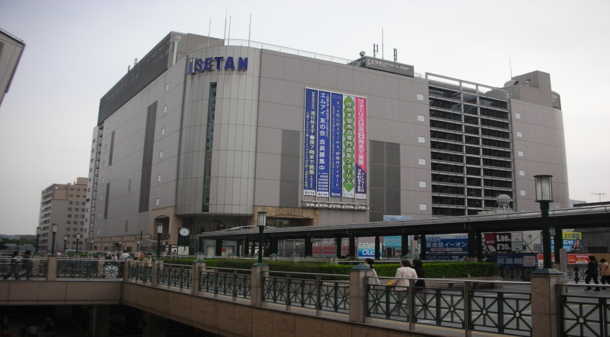
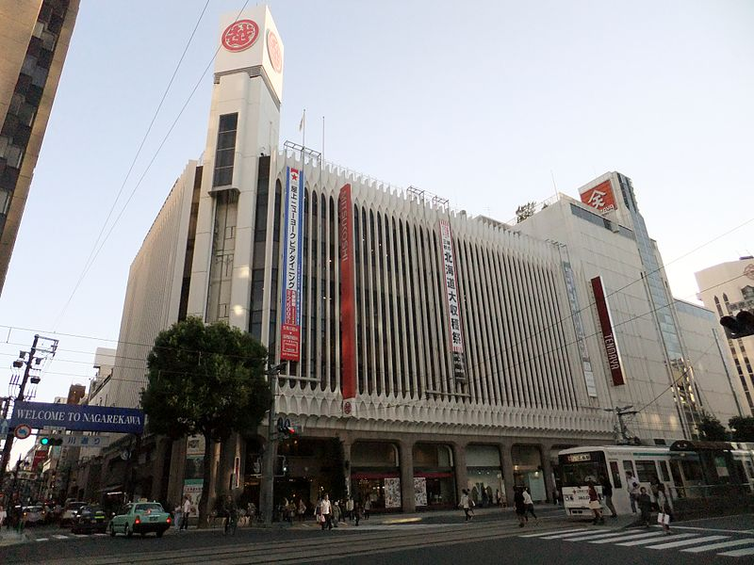
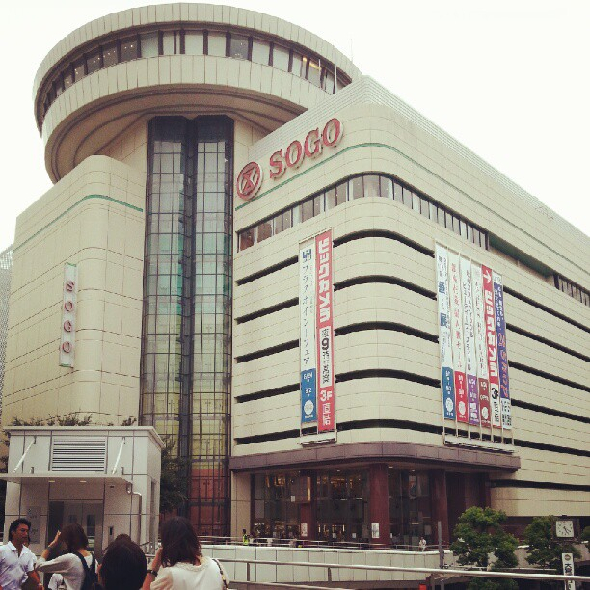
Q10. Which is the oldest department store in Japan?
あ
い
ISETAN
いせたん
TAKASHIMAYA
たかしまや
う
え
Founded in 1673
MITSUKOSHI
みつこし
SOGO
そごう
Copyright(c)The Japan Foundation, Sydney 2016

Slide 21
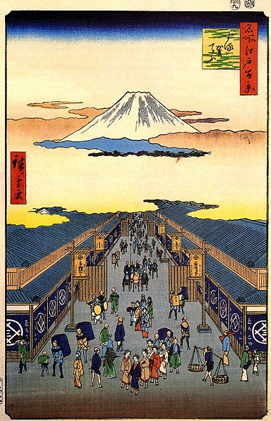
Precursor of MITSUKOSHI on Ukiyoe (woodblock prints)(1856-1858)
Copyright(c)The Japan Foundation, Sydney 2016

